Slide 1
Abstracts in Review Article
Language Practice
Inglés II – FIUNER

Slide 2

TEXT 1
1- What is the source of the text?
2- Who is/are the autor/s? Affiliations?
3- Read the title and provide a Spanish versión

Slide 3
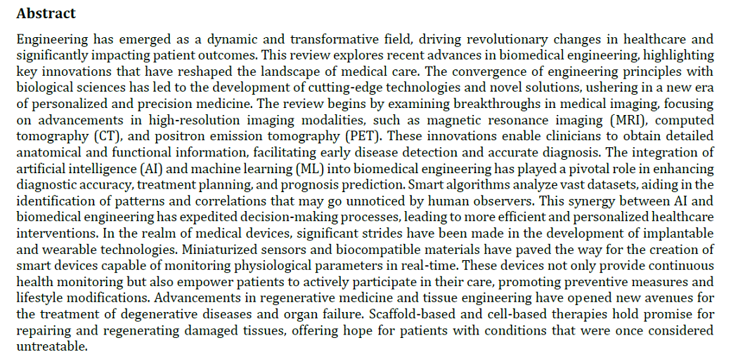
TEXT 1

Slide 4
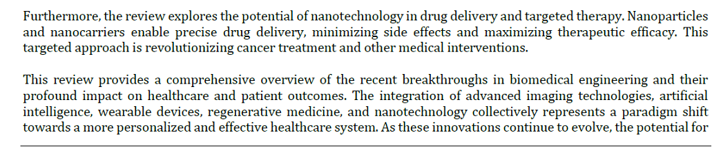
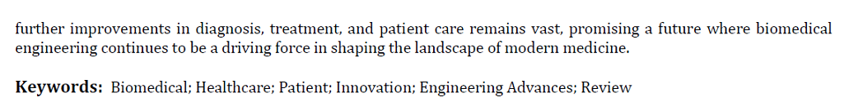
TEXT 1

Slide 5
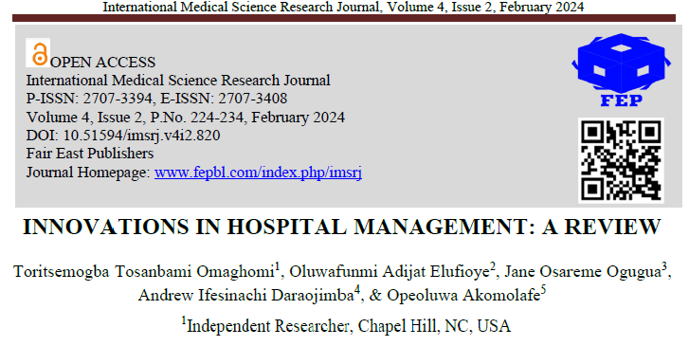
TEXT 3

Slide 6
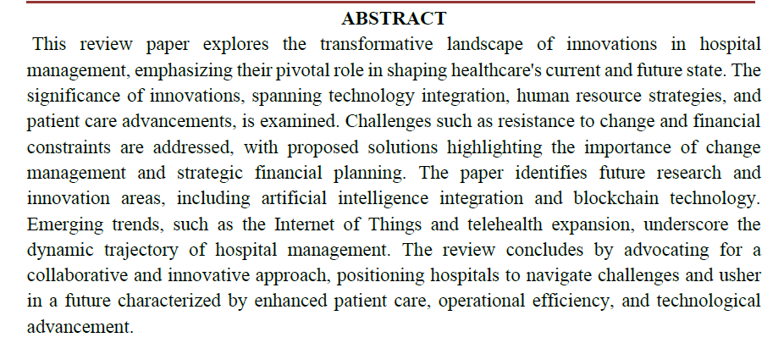
TEXT 3

Slide 7
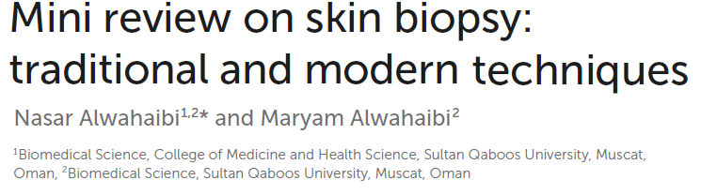
TEXT 6

Slide 8
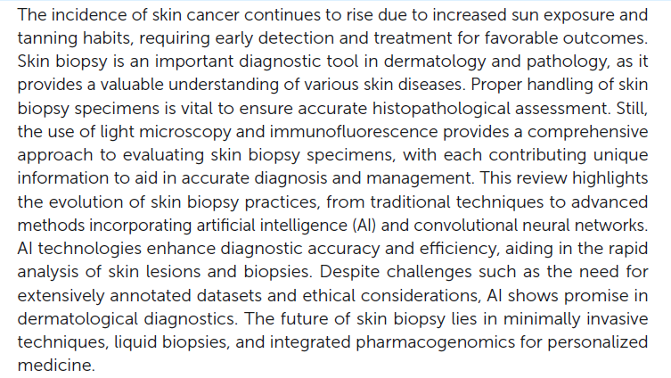

TEXT 6

